Slide 1
Logic Analysis and Design
Department of Computers, Umm Al-Qura University
2024

Slide 2
Chapter 3 : Signed Integer Representation

Slide 3
Outline
Signed Integer Representation
Arithmetic Operations on Binary Numbers

Slide 4
Signed Integer Representation
The conversions we have so far presented have involved only positive numbers.

Slide 5
Signed Integer Representation
The three common representations for signed binary numbers are:
Sign magnitude
One’s complement
Two’s complement

Slide 6
Sign magnitude
To represent negative values, computer systems allocate the high-order bit to indicate the sign of a value.
The high-order bit is the leftmost bit in a byte. It is also called the most significant bit.
The remaining bits contain the value of the number.
A positive value has a sign bit of 0 while a negative value a sign bit of 1.

Slide 7
Sign magnitude
In an 8-bit word, signed magnitude representation places the absolute value of the number in the 7 bits to the right of the sign bit.

Slide 8
Example
Positive | Negative
(01101101)₂ = +(109)₁₀ | (11101101)₂ = -(109)₁₀
(00101011)₂ = +(43)₁₀ | (10101011)₂ = -(43)₁₀
(00001100)₂ = +(12)₁₀ | (10001100)₂ = -(12)₁₀
(00011000)₂ = +(24)₁₀ | (10011000)₂ = -(24)₁₀

Slide 9
Sign magnitude
A disadvantage of signed magnitude is that it allows two different representations for zero: positive zero and negative zero. (00000000) and (10000000)
For these reasons (among others) computers systems employ complement systems for numeric value representation.

Slide 10
One’s complement
To derive –X from X in 1’s complement by inverting all the bits in the binary representation of X.
The first bit also indicates the sign of the value (0 for positive, 1 for negative).

Slide 11
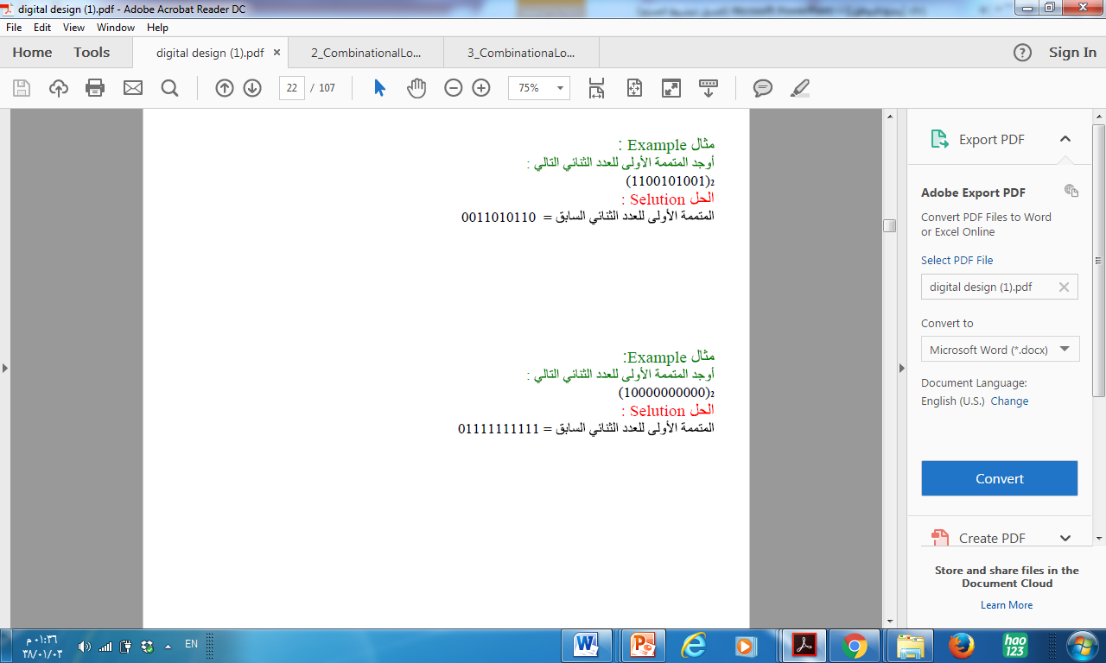

Slide 12
Example
Positive | Negative
(01101101)₂ = +(109)₁₀ | (10010010)₂ = -(109)₁₀
(00101011)₂ = +(43)₁₀ | (11010100)₂ = -(43)₁₀
(00001100)₂ = +(12)₁₀ | (11110011)₂ = -(12)₁₀
(00011000)₂ = +(24)₁₀ | (11100111)₂ = -(24)₁₀

Slide 13
Two’s complement
The first bit also indicates the sign of the value (0 for positive, 1 for negative).
Easily derive –X from X in 2’s complement by inverting all the bits in the binary representation of X, and then adding one to it.

Slide 14
Two’s complement
To express a value in two’s complement:
If the number is positive, just convert it to binary and you’re done.
If the number is negative, find the one’s complement of the number and then add 1.
Example:
In 8-bit one’s complement, positive 3 is: 00000011
Negative 3 in one’s complement is: 11111100
Adding 1 gives us -3 in two’s complement form: 11111101

Slide 15
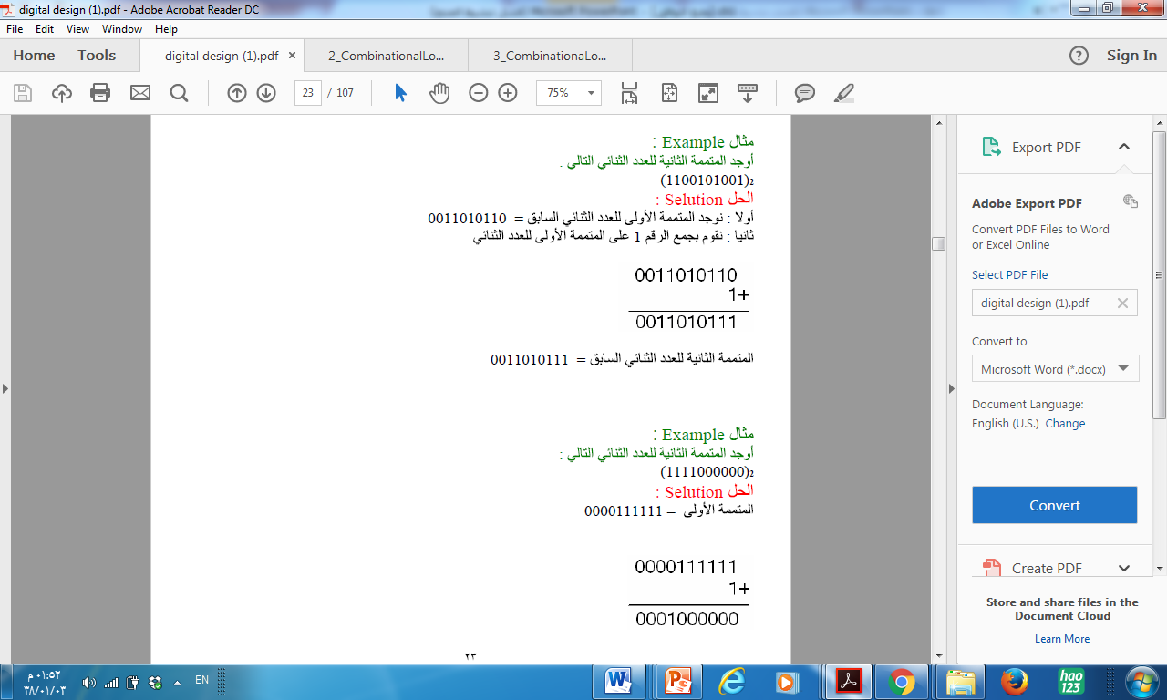

Slide 16
Example
Positive | Negative
(01101101)₂ = +(109)₁₀ | (10010011)₂ = -(109)₁₀
(00101011)₂ = +(43)₁₀ | (11010101)₂ = -(43)₁₀
(00001100)₂ = +(12)₁₀ | (11110100)₂ = -(12)₁₀
(00011000)₂ = +(24)₁₀ | (11101000)₂ = -(24)₁₀

Slide 17
Subtraction in Complement Systems
The operation A – B
Convert the operation into A + (–B)
Subtractions by 1’s Complement:
Take 1’s complement of the subtrahend
Add with minuend
If the result of above addition has carry bit 1, then add it to the least significant bit (LSB) of given result.
If there is no carry bit 1, then take 1’s complement of the result which will be negative,

Slide 18
Subtraction in Complement Systems
Example: 10101 - 00101
Take 1’s complement of 00101, which will be 11010,
Then add both of these. So, 10101 + 11010 =1 01111 . Since, there is carry bit 1, so add this to the LSB of given result, i.e., 01111+1=10000 which is the answer.

Slide 19
Subtraction in Complement Systems
Example: 0101 - 1100
Take 1’s complement of 1100, which will be 0011,
Then add both of these. So, 0101 + 0011 =0 1000 . Since, there is carry bit 0, so then take 1’s complement of the result which will be negative, i.e., 1’s complement of 1000=0111 which is the answer.

Slide 20
Subtraction in Complement Systems
The operation A – B
Convert the operation into A + (–B)
Subtractions by 2’s Complement:
Take 2’s complement of the subtrahend
Add with minuend
If the result of above addition has carry bit 1, discard the extra bit.
If there is no carry bit 1, then the two’s complement of the sum will be the result and it is negative.

Slide 21
Subtraction in Complement Systems
Example:
10110 – 11010
2’s complement of 11010 is (00101 + 1) i.e. 00110
1 0 1 1 0 + 0 0 1 1 0 = 1 1 1 0 0
As there is no carry over, the result of subtraction is negative and is obtained by writing the 2’s complement of 11100 i.e.(00011 + 1) = 00100.

Slide 22
Math Operation on Binary System
Addition
subtraction
multiplication
division

Slide 23
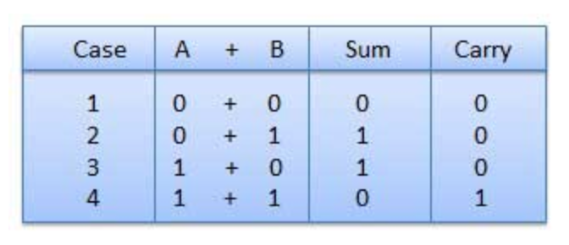
Binary Addition
There are four rules of binary addition.
sum of (1 + 1 = 10) i.e. 0 is written in the given column and a carry of 1 over to the next column.
sum of (1 + 1 + 1 = 11)

Slide 24
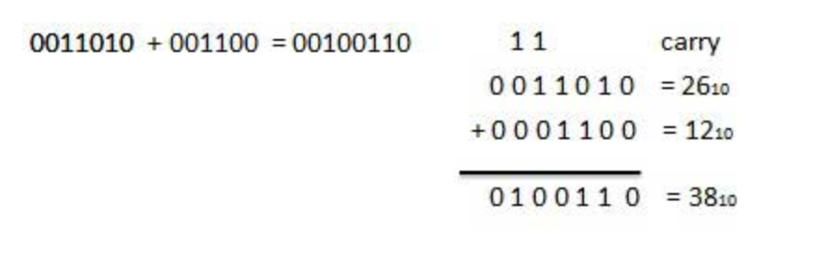
Example: Binary Addition

Slide 25
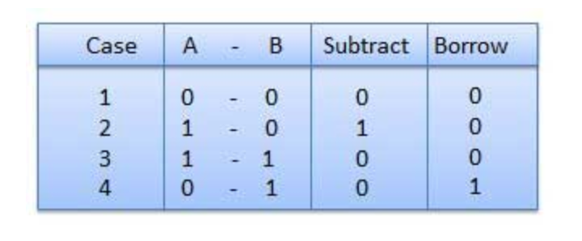

Binary Subtraction
Subtraction and Borrow, these two words will be used very frequently for the binary subtraction. There are four rules of binary subtraction.
Borrow of (0 - 1 = 10)

Slide 26
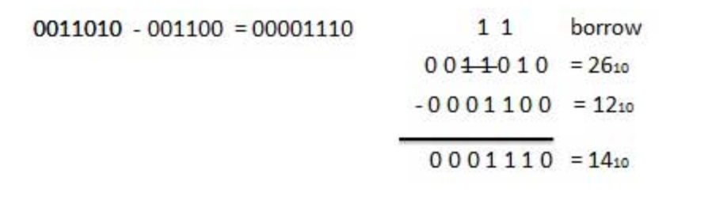
Example: Binary Subtraction
0
0

Slide 27
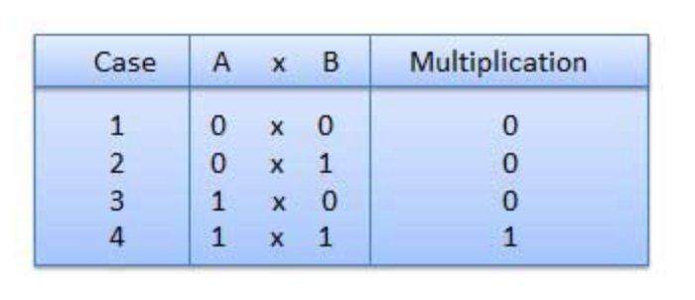
Binary Multiplication
There are four rules of binary multiplication.

Slide 28
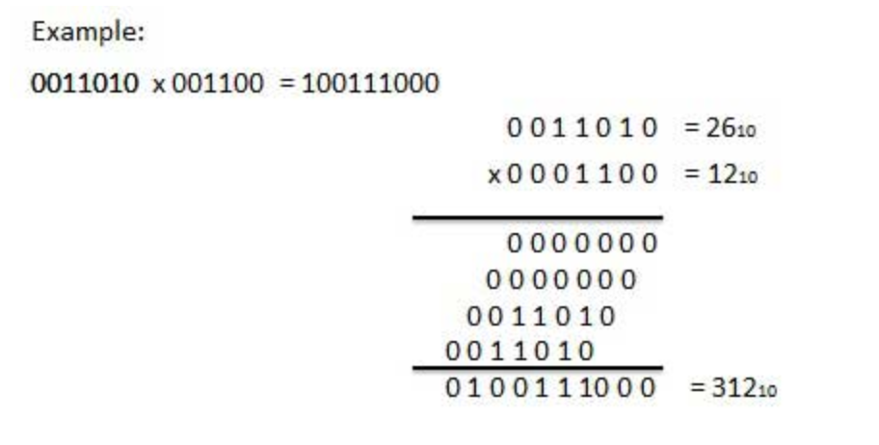
Example: Binary Multiplication

Slide 29
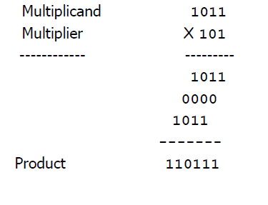
Example: Binary Multiplication
Consider the following example:
Multiply (1011)2 by (101)2
Solution:

Slide 30
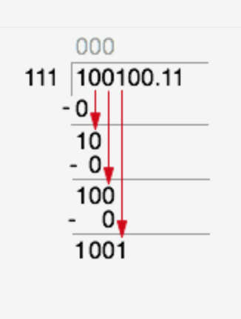

Binary Division
The long division procedure.
We take the first digit in our dividend and attempt to divide it by our divisor.
In this case, it doesn’t fit so we write a 0 in the first column of our result.
Calculate the product.
Subtract result from our dividend.
So on..

Slide 31
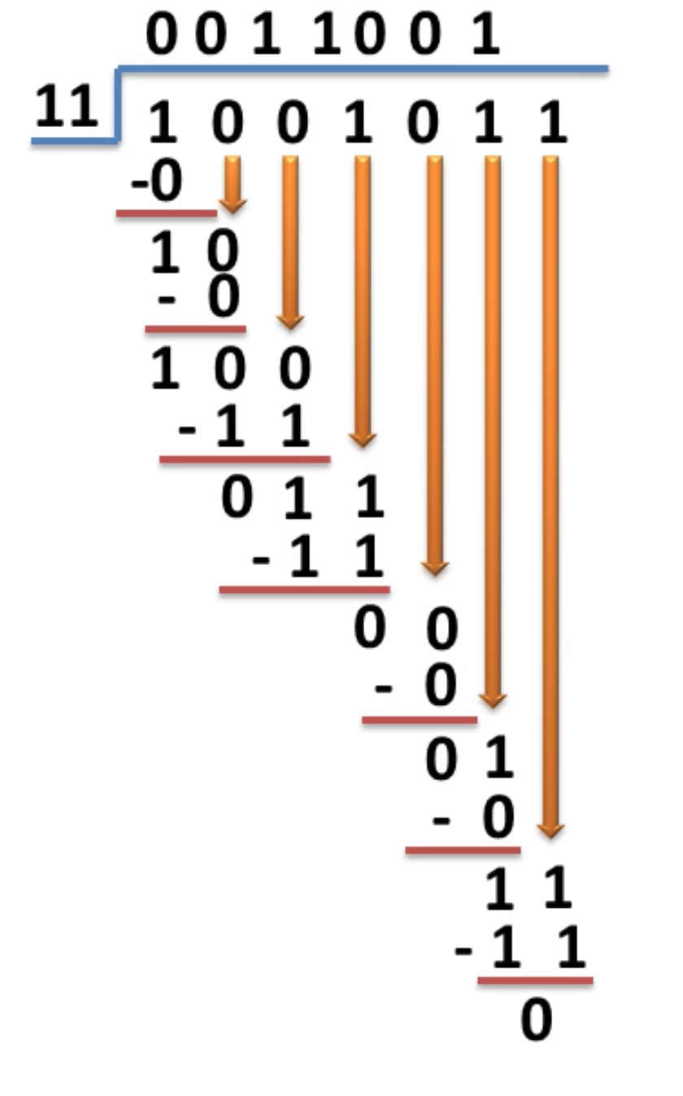
Binary Division
Example − Division

Slide 32
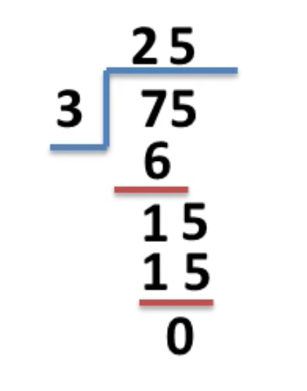
Binary Division
Example − Division

